Slide 1

Lab 06 THE IKS01A2 MODULE
Prof. Davide Brunelli
Dept. of Industrial Engineering – DII
University of Trento, Italy
davide.brunelli@unitn.it

Slide 2
USART
Preliminary downloads

Slide 3
Preliminary downloads
Before we start, please download all the file contained inside the drive folder:
https://drive.google.com/drive/folders/1BfbaYt5Bvy6v2NRF1YHlKbplc5kHMwEZ?usp=sharing
3

Slide 4
USART
I2C

Slide 5
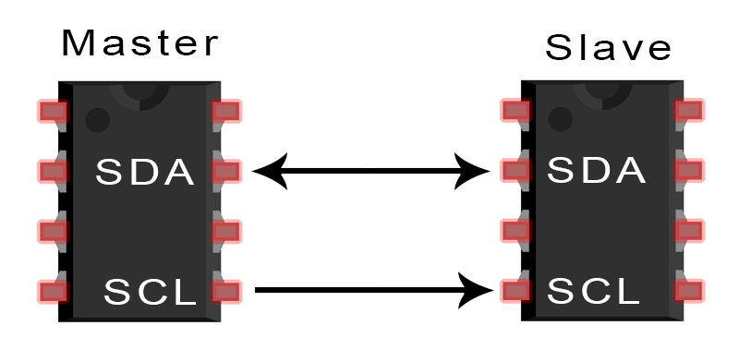
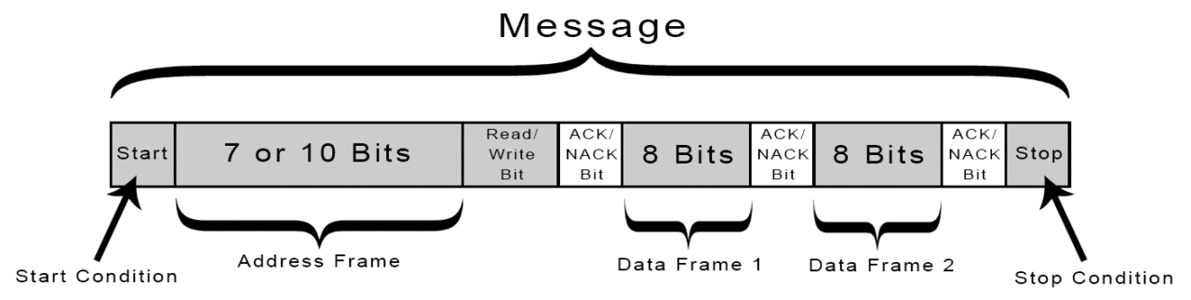
STM32 I2C
Inter Integrated Circuit (I2C) is a serial communication protocol for exchanging data between a master and one or more slaves.
The I2C allows for synchronous communication thanks to a line reserved for the clock signal (SCL – Serial Clock). Data are exchanged through a second line called SDA – Serial Data.
Addressing is done with a single line by using the address slave.
5

Slide 6
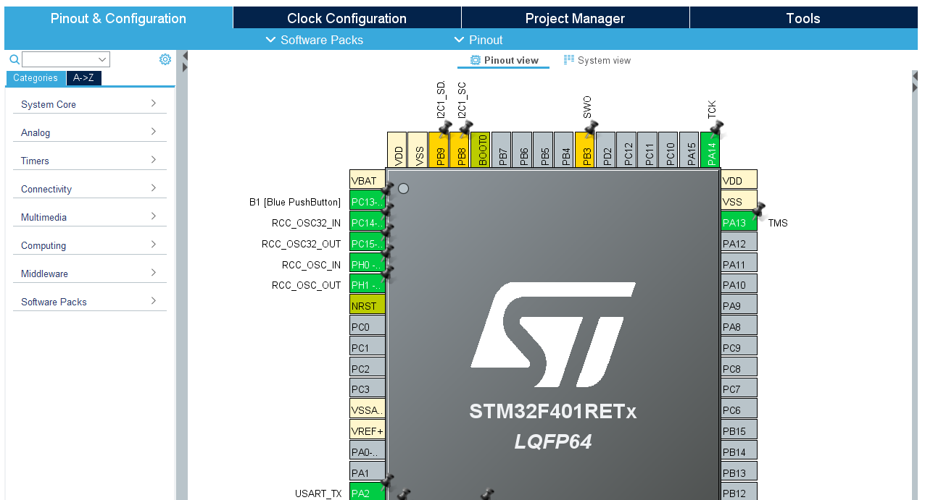
STM32 i2c
Pin PB8 and PB9 can be multiplexed to the SCL and SDA lines.
PB8 = I2C SCL
PB9 = I2C SDA
6

Slide 7
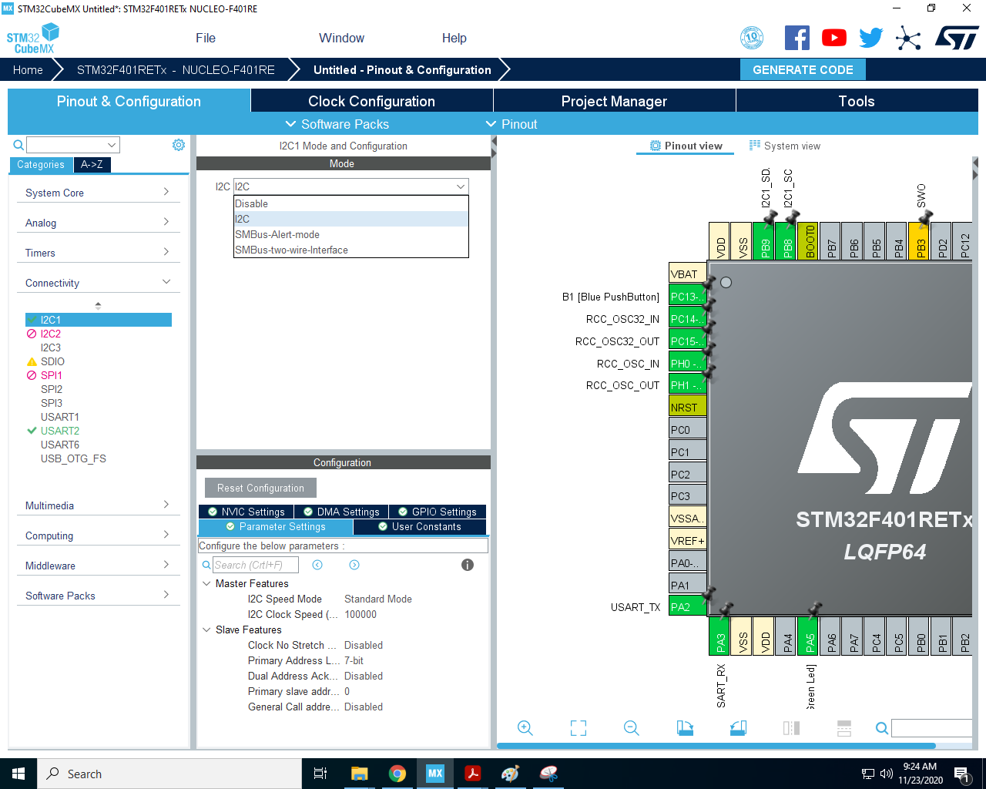
STM32 USART
I2C parameters can be configured as always using CubeMX.
As a first step, set I2C as the I2C1 mode. We will come back later on this.
7

Slide 8
X-NUCLEO-IKS01A2

Slide 9
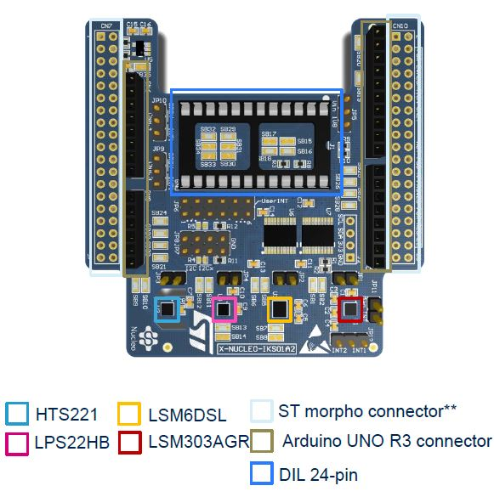
X-NUCLEO-IKS01A2
The X-NUCLEO-IKS01A2 is a motion MEMS and
environmental sensor evaluation board system.
LSM6DSL : MEMS 3D accelerometer (±2/±4/±8/±16 g) + 3D gyroscope (±125/±245/±500/±1000/±2000 dps)
LSM303AGR : MEMS 3D magnetometer (±50 gauss) + MEMS 3D accelerometer (±2/±4/±8/±16 g)
LPS22HB : MEMS pressure sensor, 260-1260 hPa absolute digital output barometer
HTS221 : Capacitive digital relative humidity and temperature
DIL 24-pin : Socket available for additional MEMS adapters and other sensors (UV index)
9

Slide 10
ADC
X-cube-mems1

Slide 11
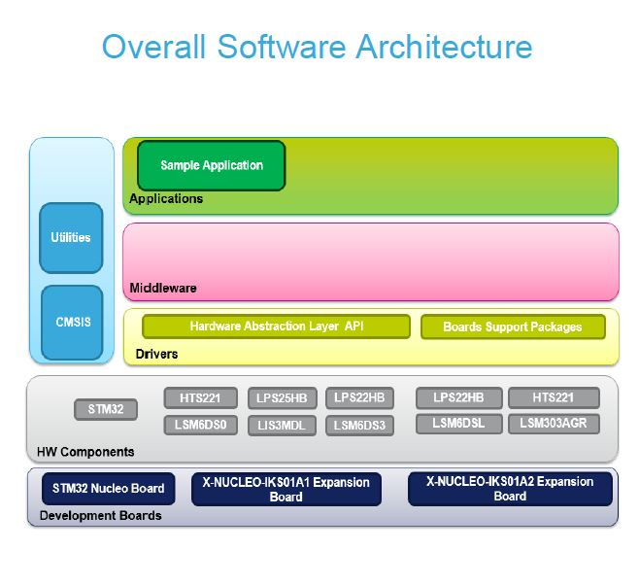
X-cube-mems1
The X-CUBE-MEMS1 software package is an expansion for
STM32Cube, associated with the X-NUCLEO-IKS01A2
expansion board.
Complete middleware to build applications using temperature and humidity sensors (HTS221), pressure sensor (LPS22HB) and motion sensors (LSM303AGR and LSM6DSL)
Sample application to transmit real-time sensor data to a PC
PC-based application (Windows®) to log sensor data
Low-power optimization (suitable for the STM32L0 MCU family)
Free, user-friendly license terms
11

Slide 12
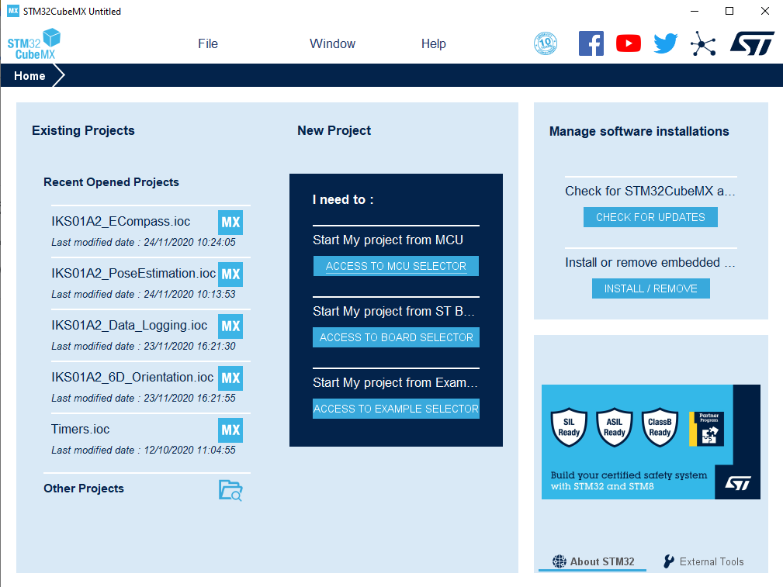
X-cube-mems1 - installation
12

Slide 13
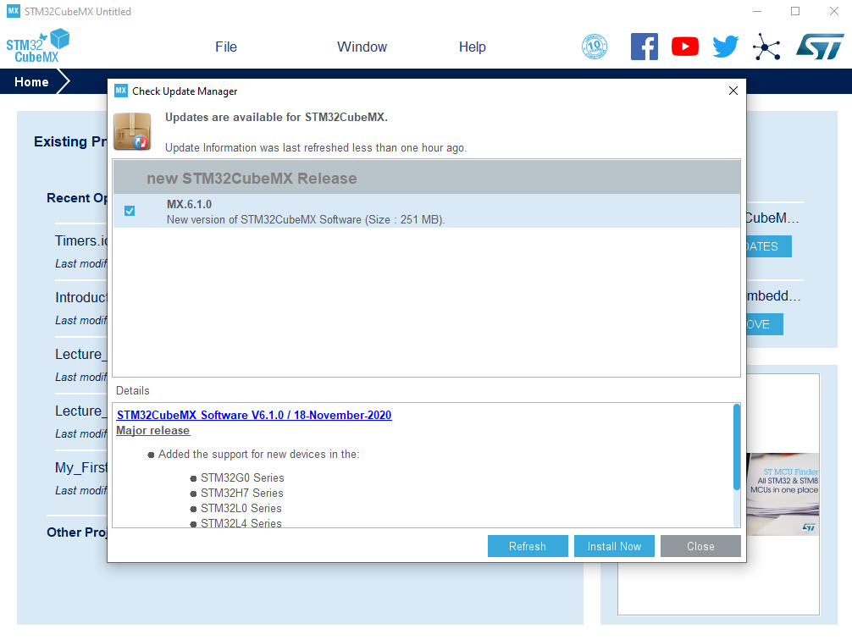
X-cube-mems1 - installation
13

Slide 14
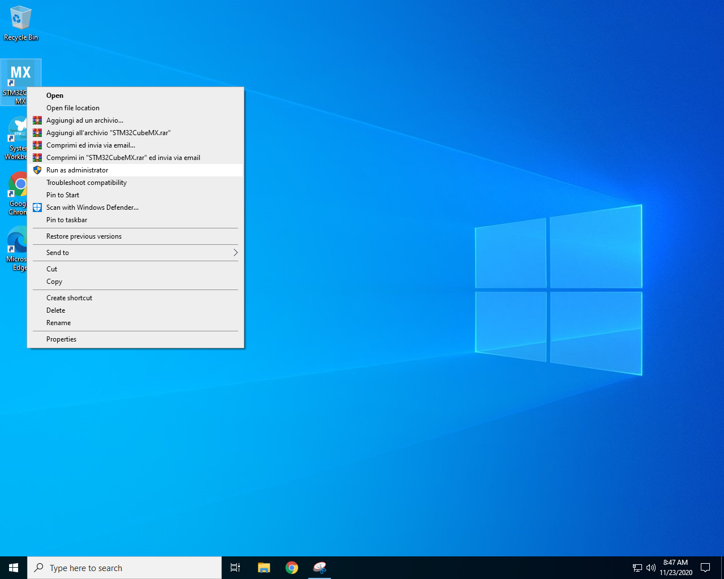
X-cube-mems1 - installation
Once updated, close it and re
open it as an administrator
14

Slide 15
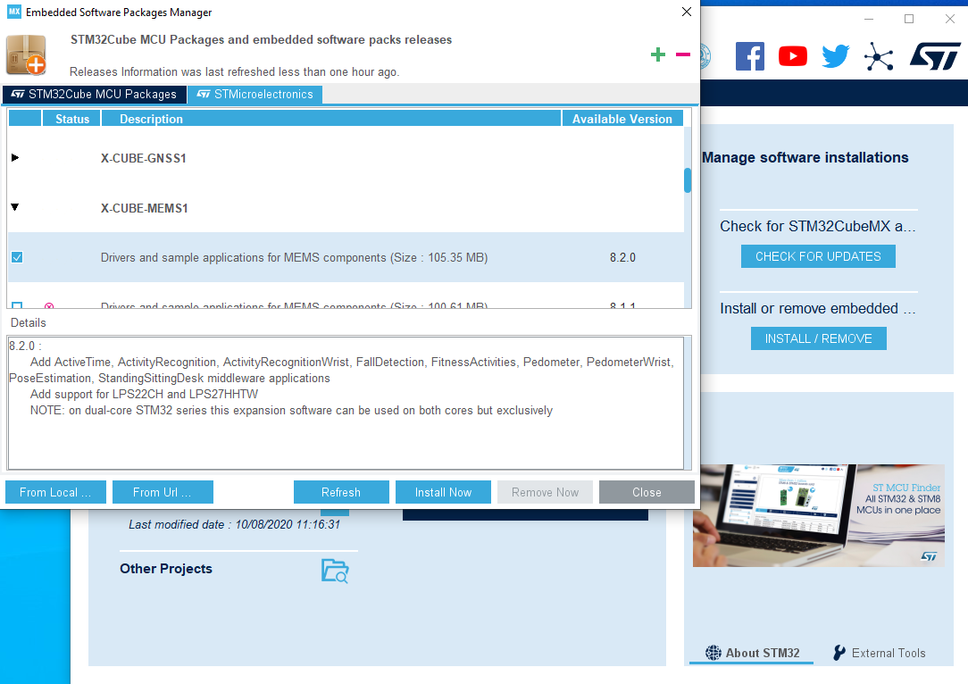
X-cube-mems1 - installation
15

Slide 16
X-cube-mems1 - installation
Once updated, close it and re
open it as an administrator
16

Slide 17
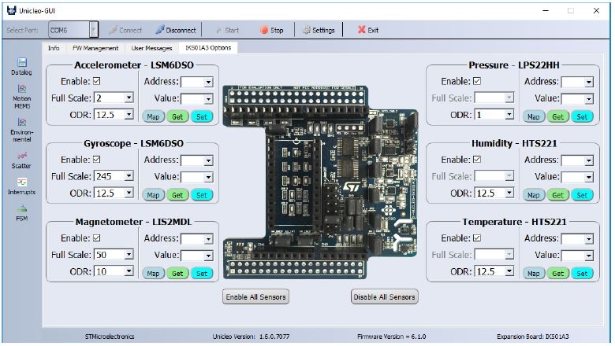
X-cube-mems1 – unicleo gui
Unicleo-GUI is a graphical user interface (GUI) for the X-CUBE-MEMS1 software expansions and STM32 Nucleo
expansion boards like the X-NUCLEO-IKS01A1.
The main objective of this application is to demonstrate the functionality of the embedded ST sensors and
algorithms.
17

Slide 18
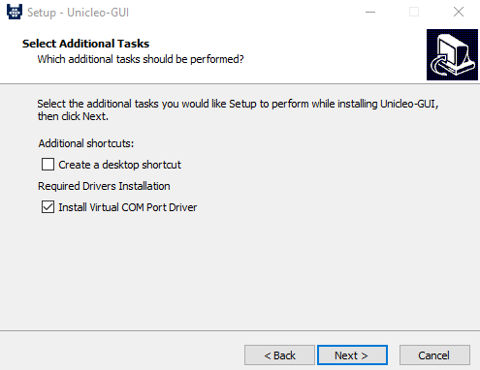
X-cube-mems1 – unicleo gui
Install it by unzipping the en.Setup_Unicleo.zip archive
and run the executable.
Be sure to check the Install Virtual COM Port Driver option.
18

Slide 19
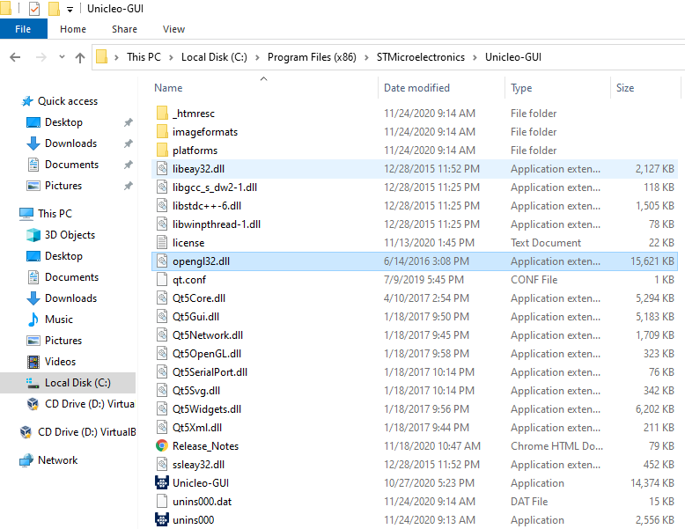
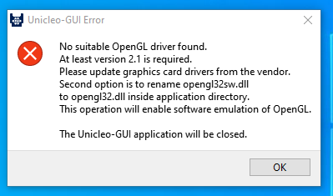
X-cube-mems1 – unicleo gui
If you get this error, just browse for
the path were you installed the
Unicleo-GUI, look for the
opengl32sw.dll file and rename it
as opengl32.dll
19

Slide 20
ADC
Iks01a2 – data log terminal

Slide 21
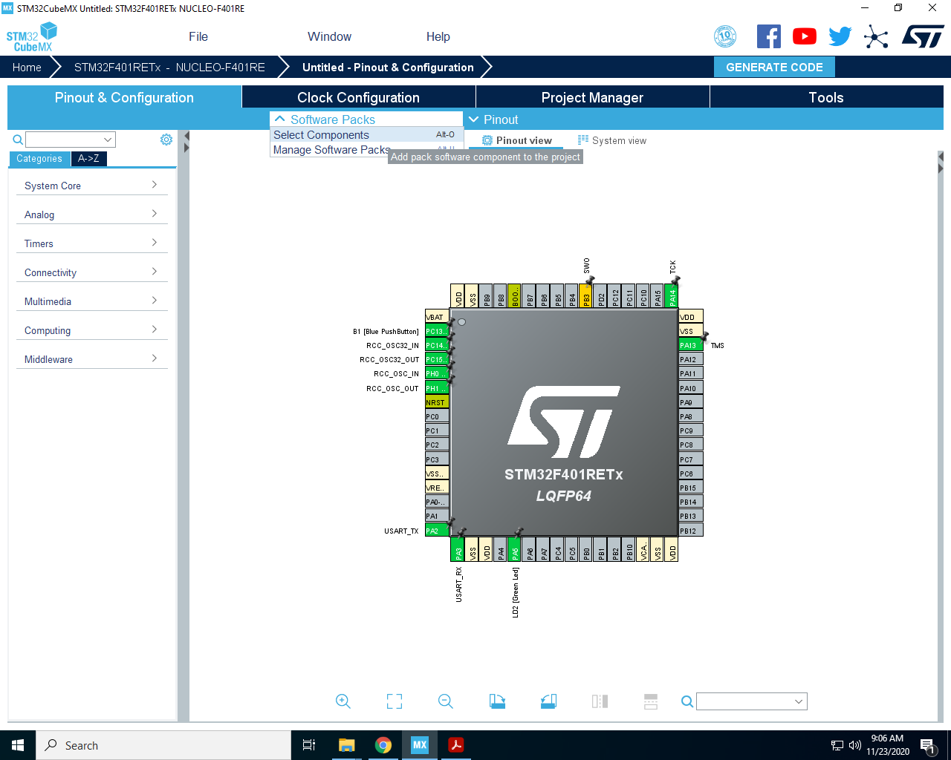
Iks01a2 – data log terminal
21

Slide 22
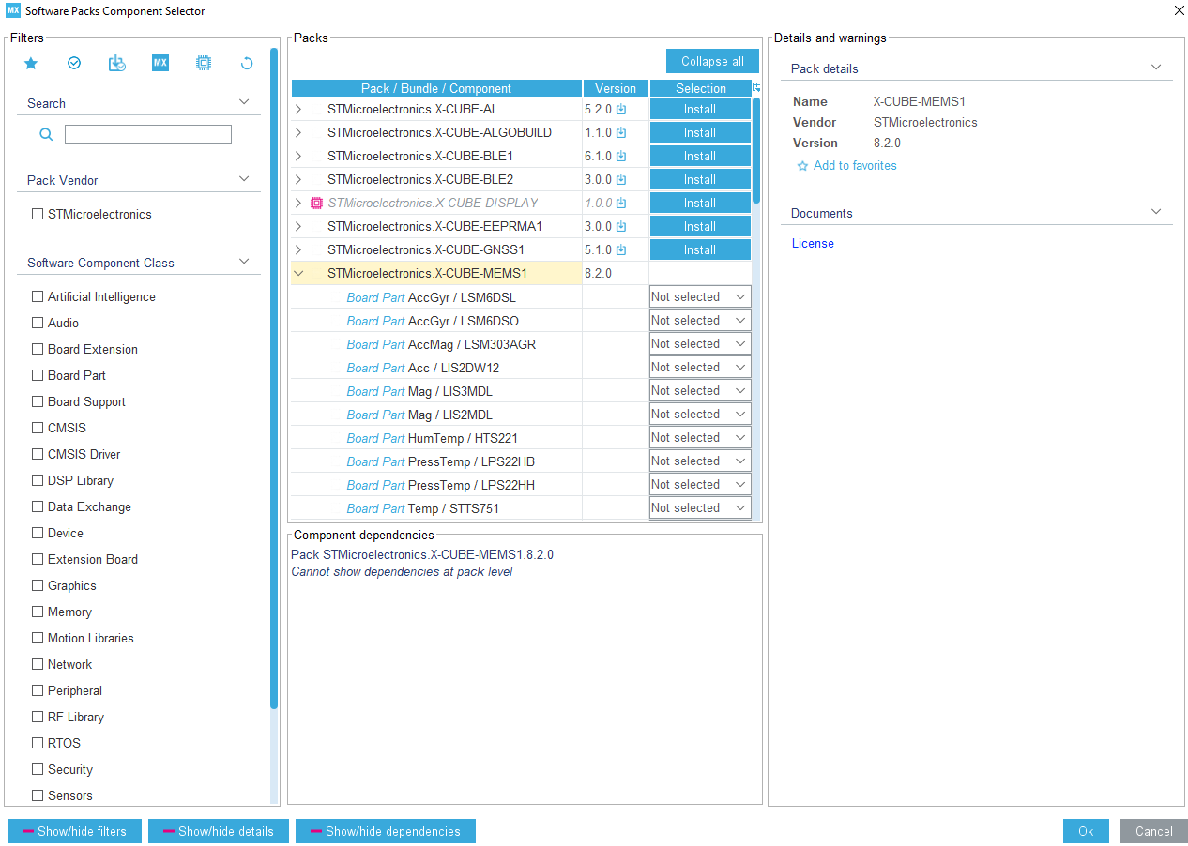
Iks01a2 – data log terminal
22

Slide 23
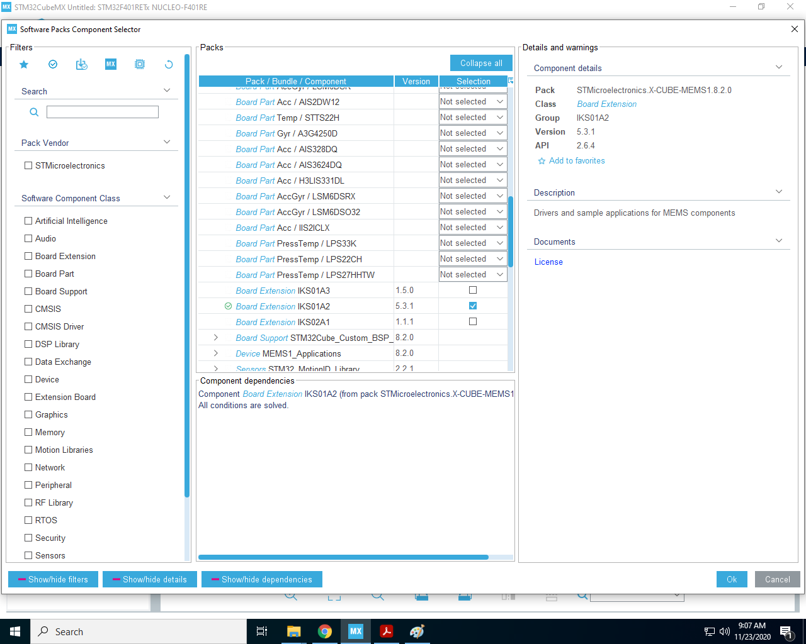
Iks01a2 – data log terminal
Scroll down and check
IKS01A2 as Board Extension
23

Slide 24
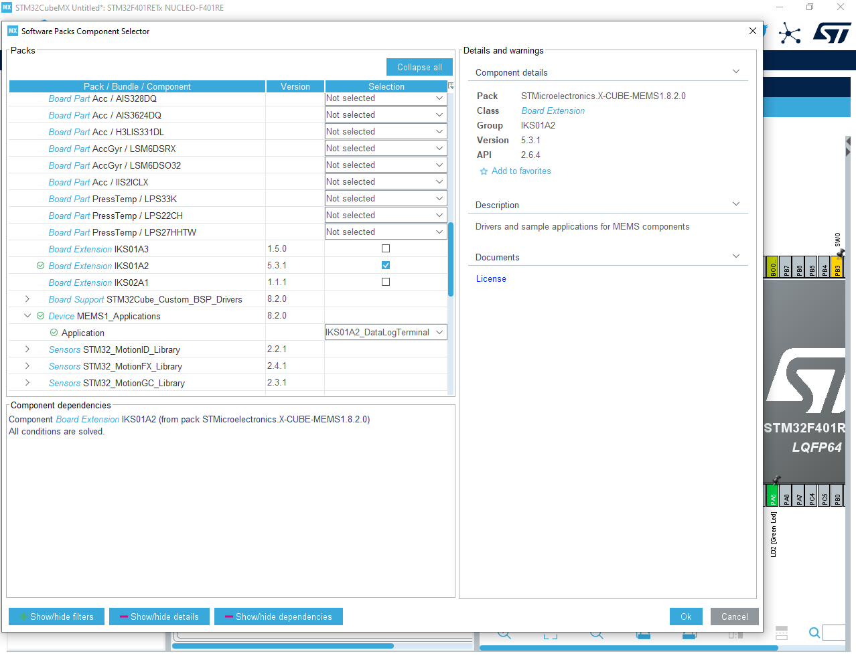
Iks01a2 – data log terminal
Here you can select the
pre-compiled application
to test.
Select
IKS01A2_DataLogTerminal
24

Slide 25
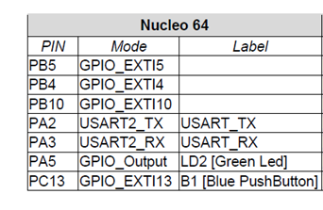
Iks01a2 – data log terminal
From the Pinout scheme, if not already set, set:
25

Slide 26
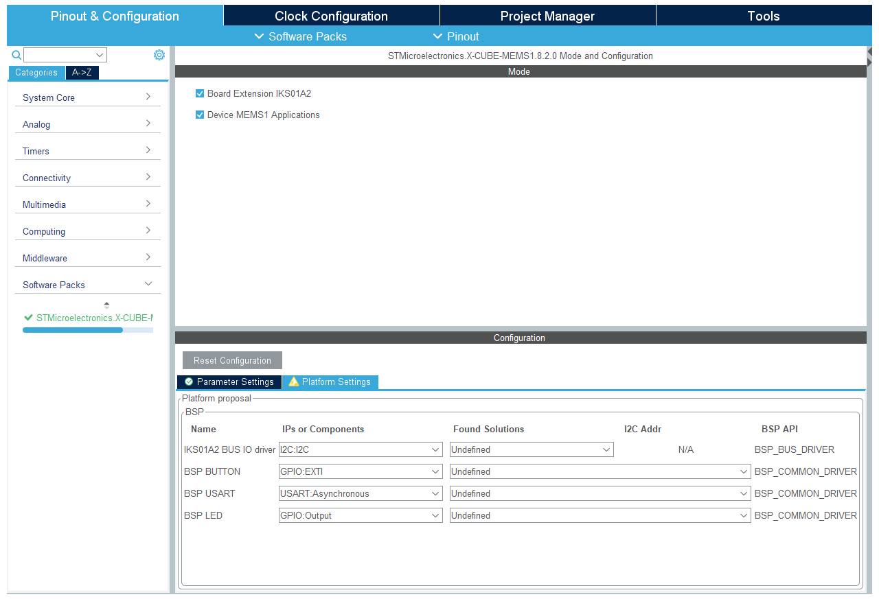
Iks01a2 – data log terminal
26

Slide 27
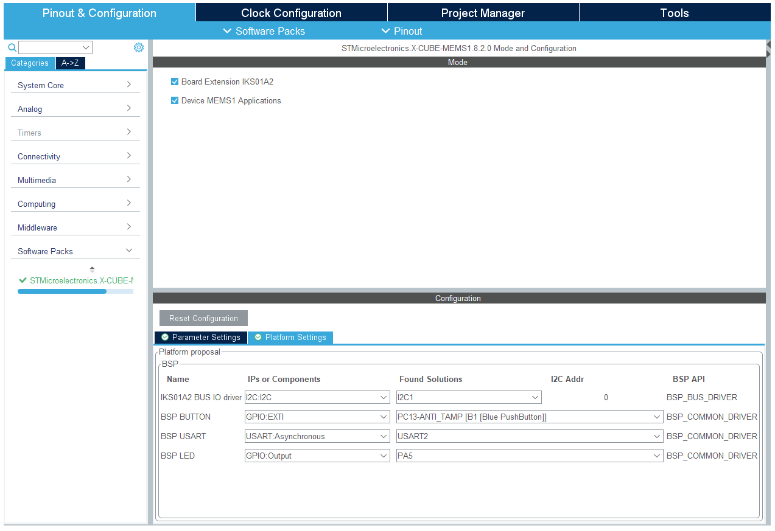
Iks01a2 – data log terminal
27

Slide 28
Iks01a2 – data log terminal
28

Slide 29
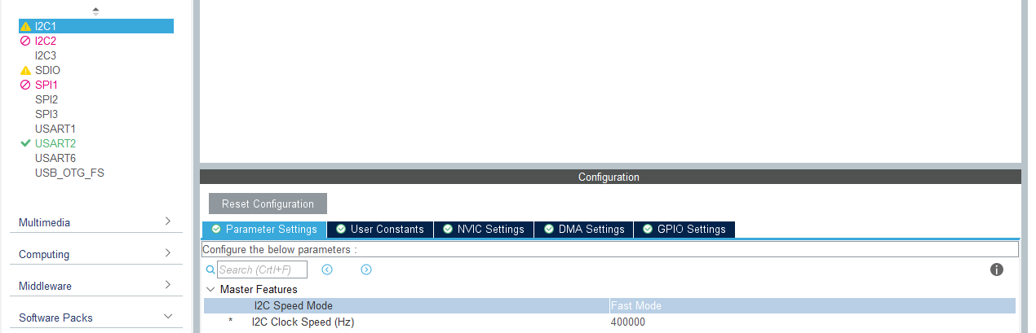
Iks01a2 – data log terminal
29

Slide 30
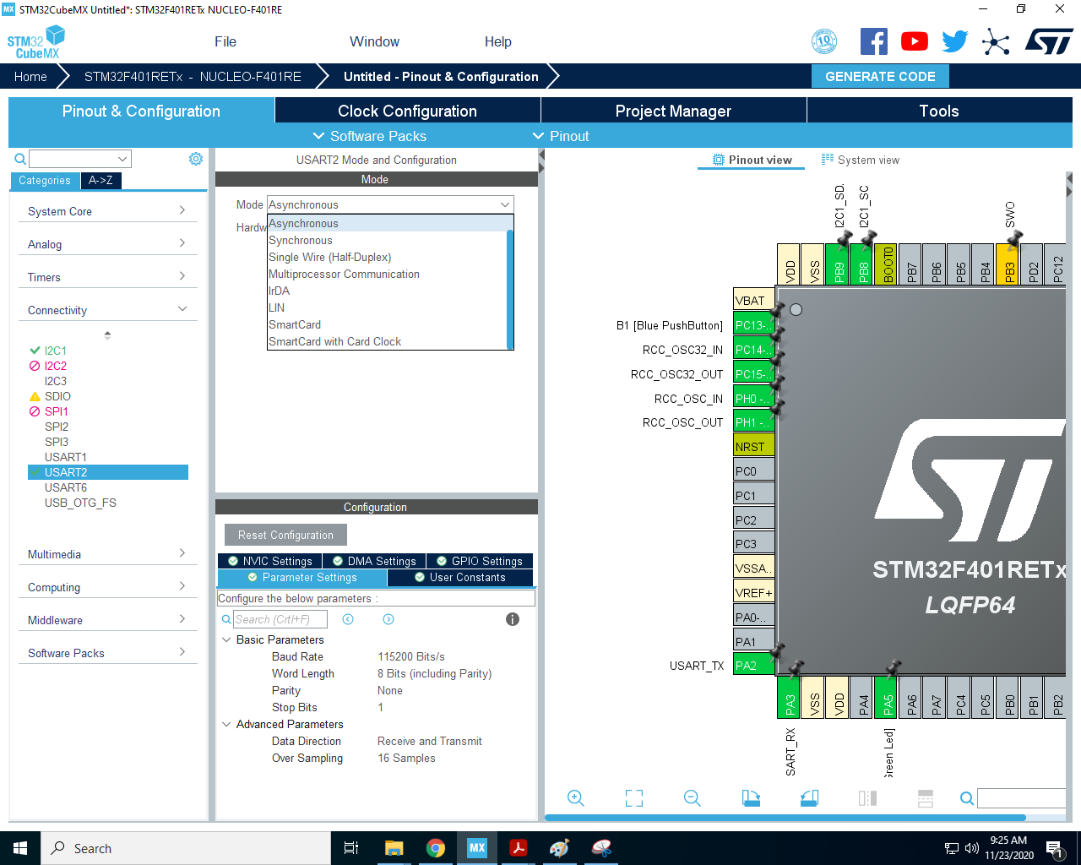
Iks01a2 – data log terminal
30

Slide 31
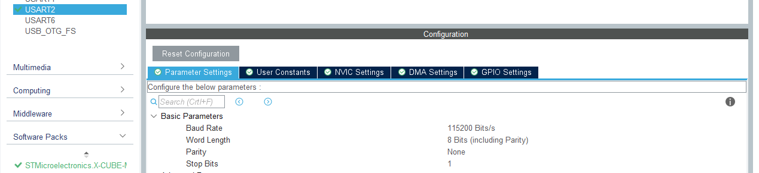
Iks01a2 – data log terminal
31

Slide 32
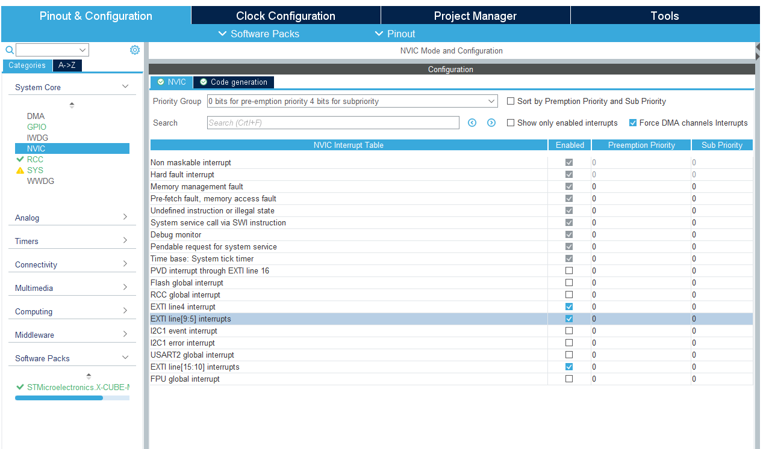
Iks01a2 – data log terminal
32

Slide 33
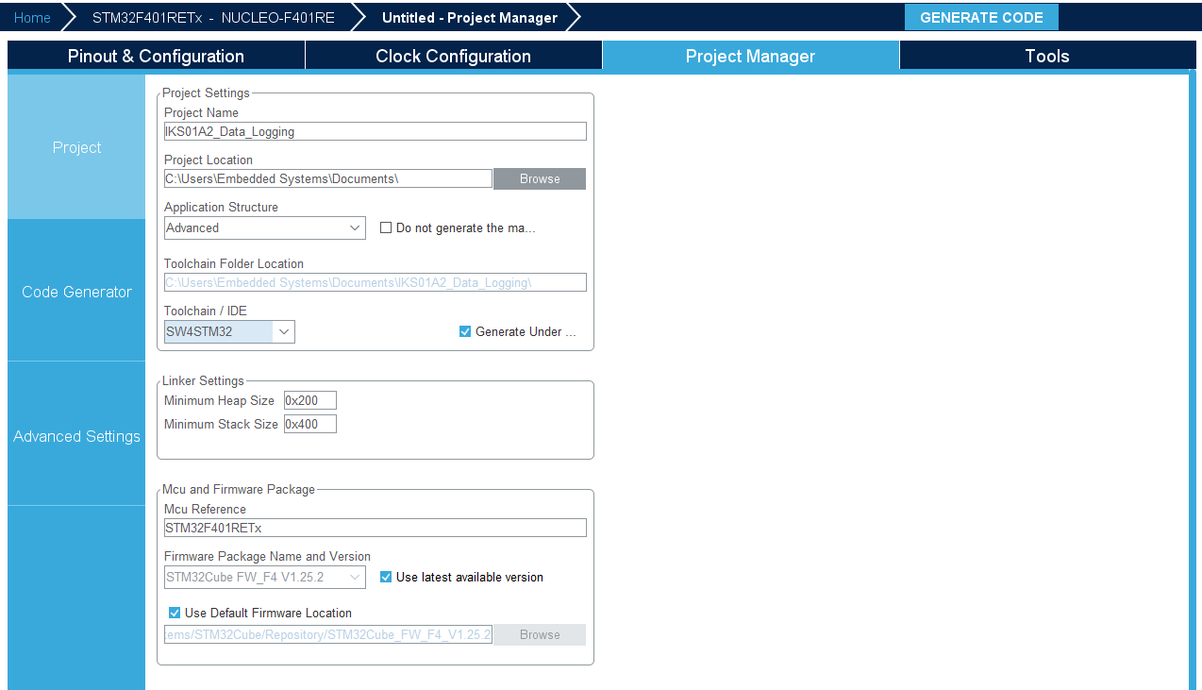
Iks01a2 – data log terminal
33

Slide 34
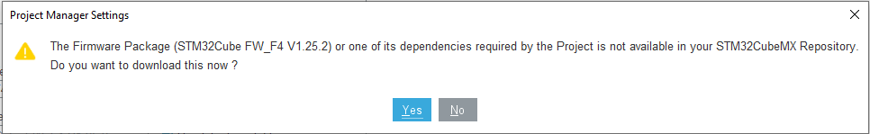
Iks01a2 – data log terminal
Download the Firmware package and you are ready to go!
34

Slide 35
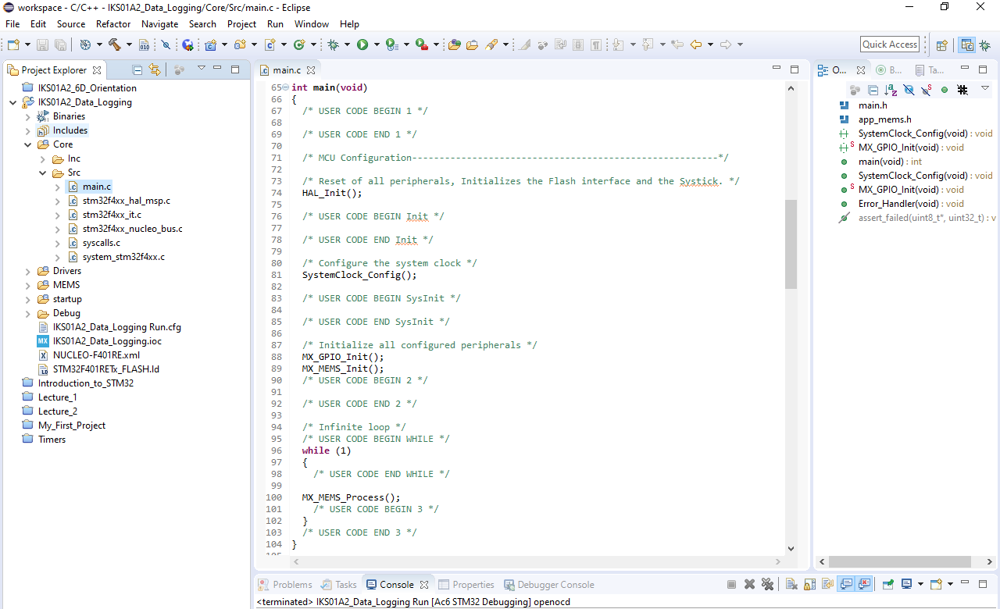
Iks01a2 – data log terminal
You can find the main.c file in
Core->Src
35

Slide 36
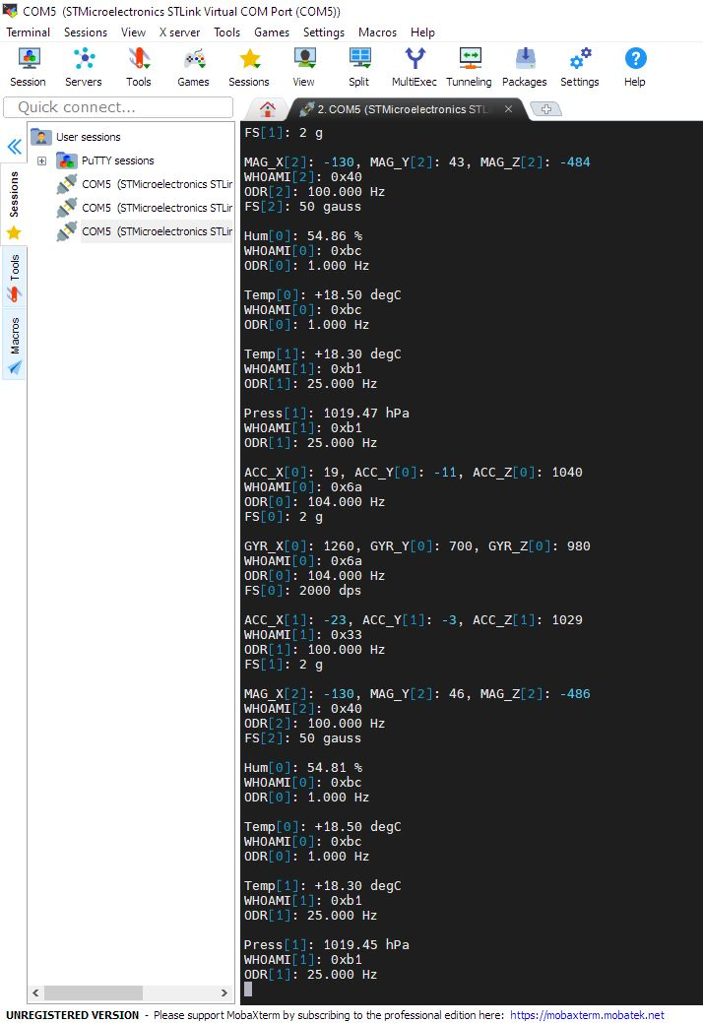
Iks01a2 – data log terminal
Once you flash the firmware, you can visualize the streaming data
through MobaXTerm by setting a Serial session with
Baudrate 115200
36

Slide 37
ADC
Iks01a2 – 6d orientation estimator

Slide 38
6d orientation estimator
Import the 6D Orientation estimator application and flash it on your Nucleo board.
Use CubeMX to select the IKS01A2_LSM6DSL_6DOrientation in Software Packs->Select Components as we have done for the datalogger.
Set the Platform settings as shown in the next slide
Flash your Nucleo board.
Look at the data streaming using MobaXTerm.
38

Slide 39
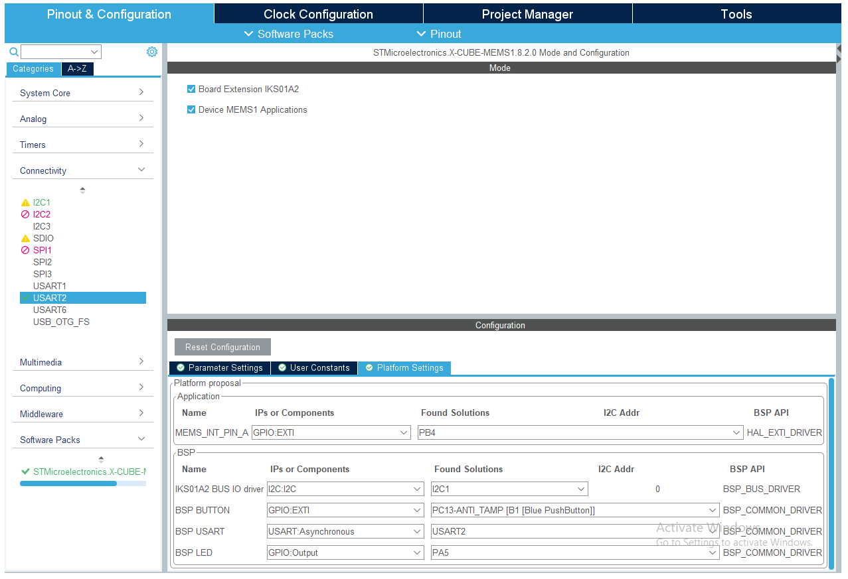
6d orientation estimator
Access the X-Cube-MEMS Software pack
39

Slide 40
ADC
Iks01a2 – testing applications with the unicleo gui

Slide 41
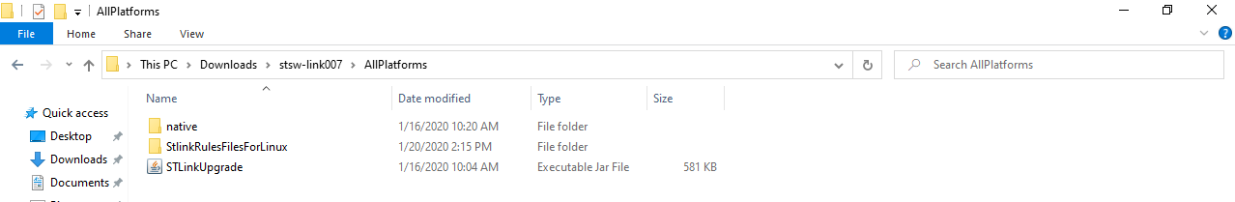
Unicleo gui and applications
Extract the archive en.stsw-link007_V2-36-26.zip and run the STLinkUpgrade file in stsw-link007->AllPlatforms
41

Slide 42
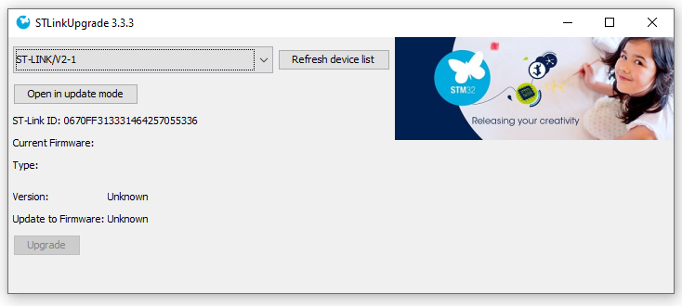
Unicleo gui and applications
If not greyed out, hit the Upgrade option to upgrade your ST-LINK firmware
42

Slide 43
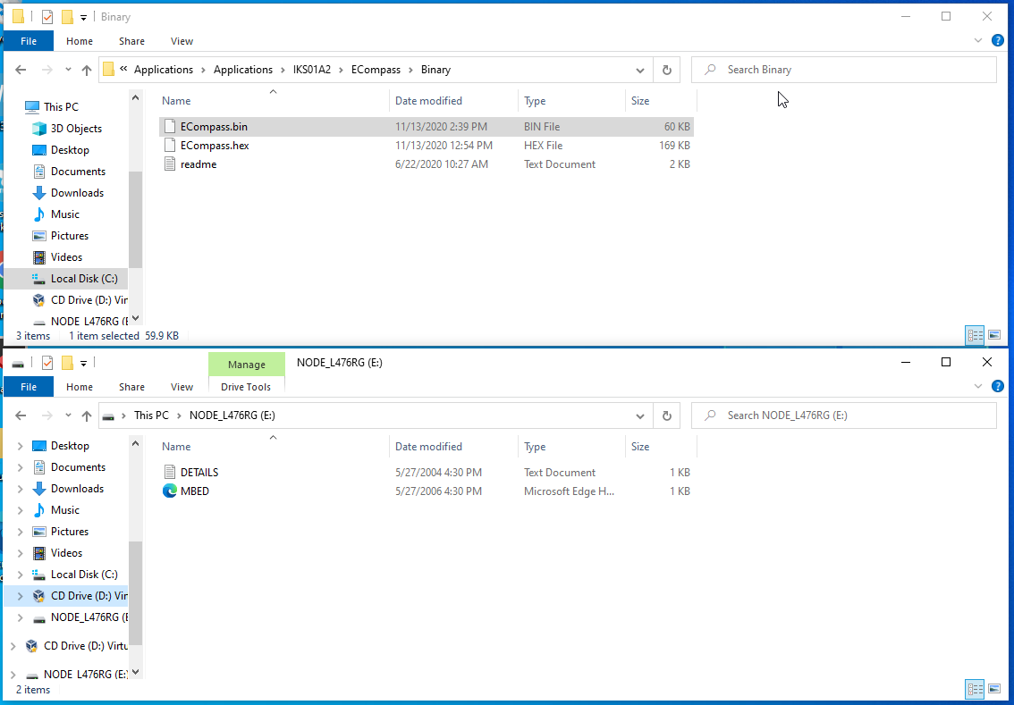
Unicleo gui and applications
Unzip the Applications_L476RG.rar archive, enter the IKS01A2 folder and click on the folder of the application you want to flash onto the Nucleo board.
Then enter the Binary folder and copy the .bin file onto your Nucleo board (access your board by clicking on the NODE_L476RG drive)
43

Slide 44
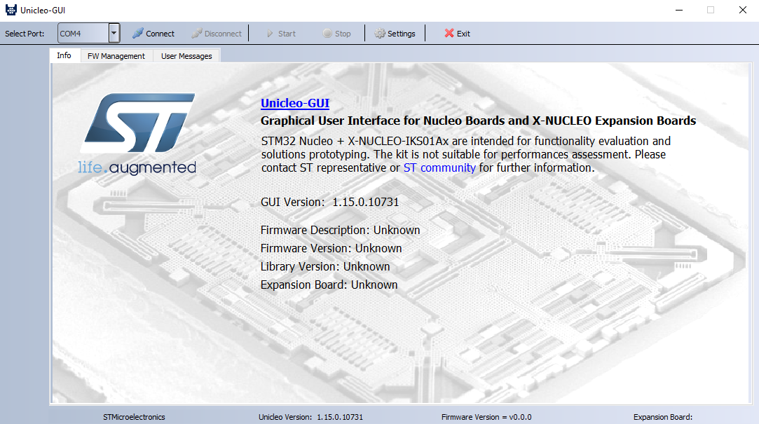
Unicleo gui and applications
Run the Unicleo-GUI, select the proper COM port and hit Connect
44

Slide 45
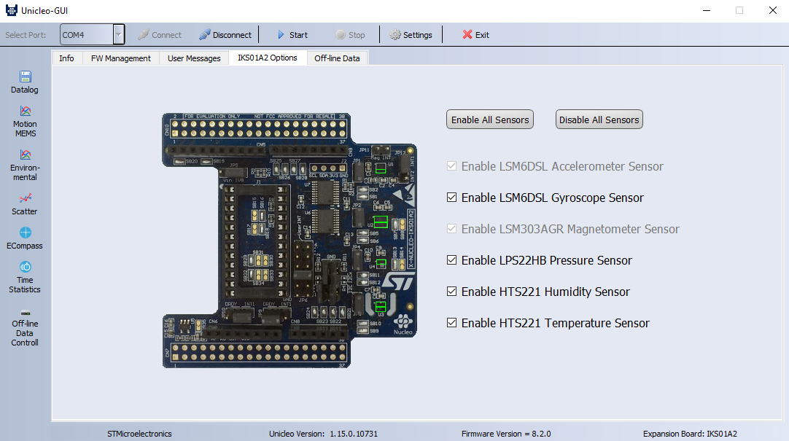
Unicleo gui and applications
45

Slide 46
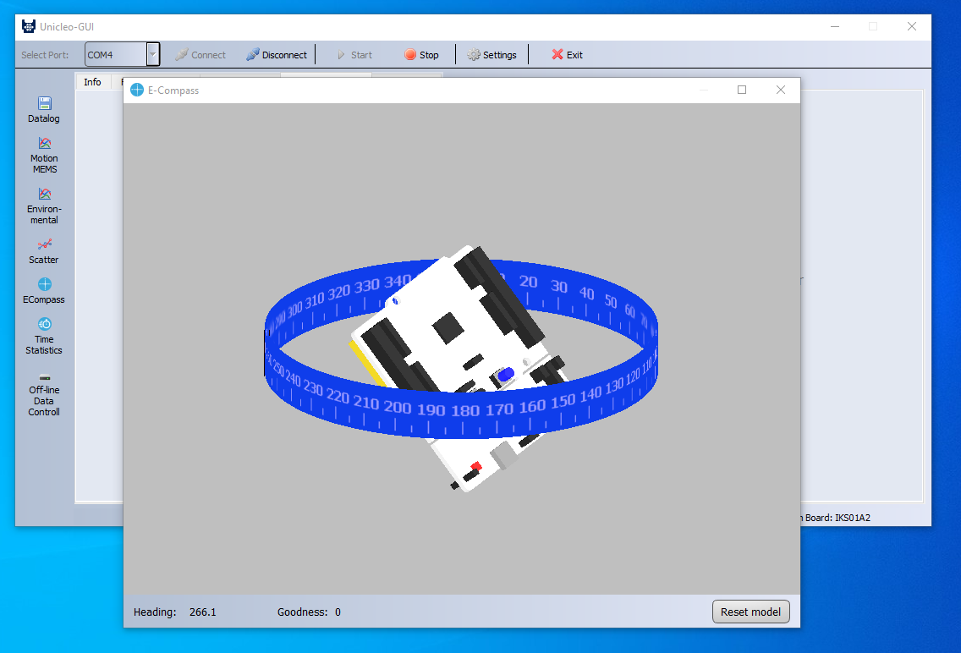
Unicleo gui and applications
Click on the icon with the name of the flashed application to visualize its HMI
46

Slide 47
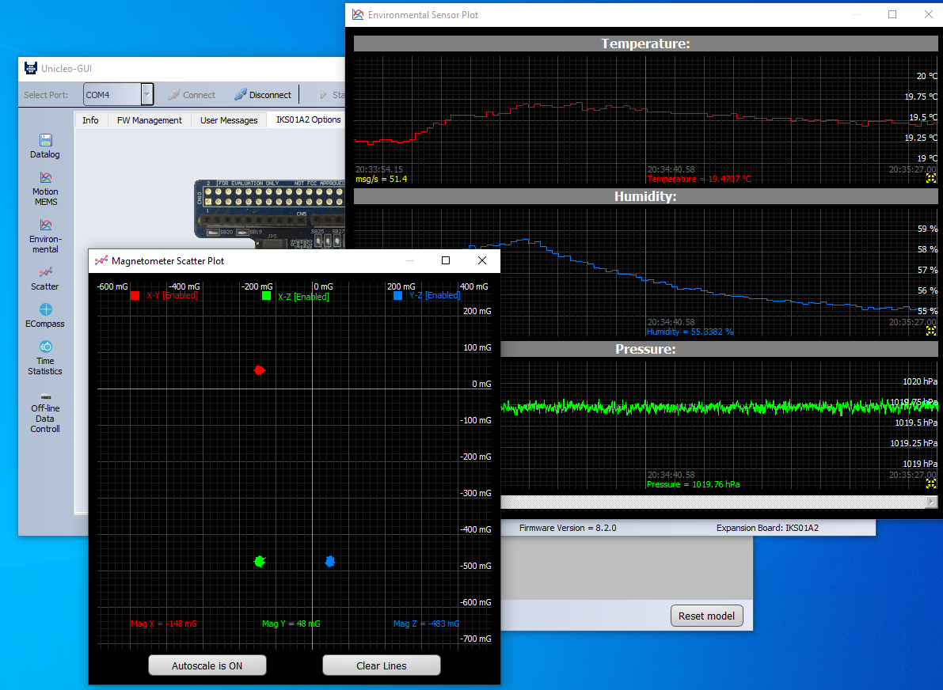
Unicleo gui and applications
You can even visualize additional data
47

Slide 48
Additional resources
You can find a complete overview of Cube MEMS as well as all the details for the applications contained in the Applications.rar archive in the pdf STMicroelectronics.X-CUBE-MEMS1_GettingStarted.
You can find a complete overview of the Unicleo-GUI in the pdf dm00337036
This two pdf as well as all the file mentioned in these slides are contained in the drive folder:
https://drive.google.com/drive/folders/1BfbaYt5Bvy6v2NRF1YHlKbplc5kHMwEZ?usp=sharing
48

